Slide 1


Slide 2

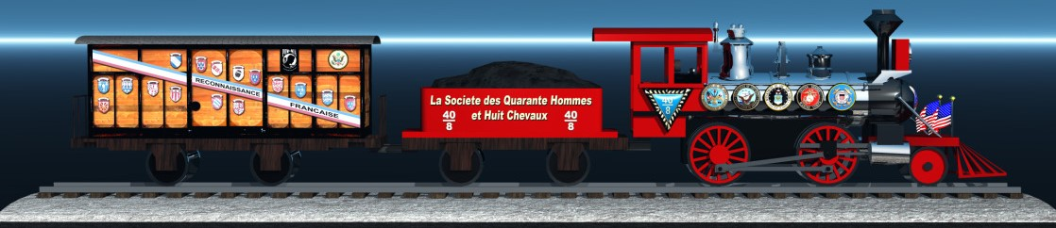
WELCOME
The Forty and Eight/ La Societe des Quarante Hommes et Huit Chevaux.
Names come from the French railroad and its 40/8 Boxcars.
The Forty and Eight is a Fraternal and Charitable Honor Society of American Veterans.
Membership is by invitation only.

Slide 3
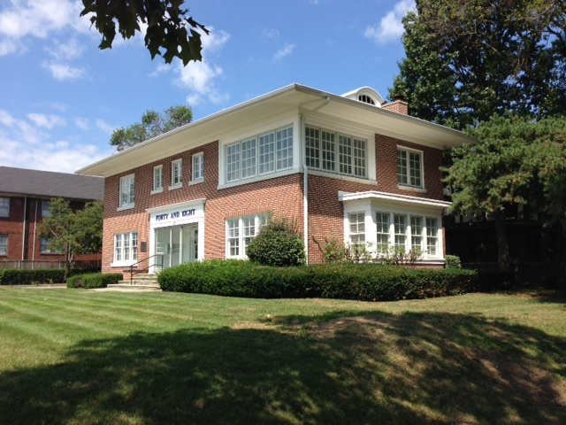
40/8 NATIONAL HEADQUARTERS INDIANAPOLIS, INDIANA
Notes:
This is a picture of the new National Home of the Forty and Eight in Indianapolis Indiana purchased in 2014.

Slide 4
HISTORY
Formed on March 15,1920 by Joseph W. Breen and 15 other prominent members of the newly formed American Legion.
The vision for the organization was for a new and different level of membership and camaraderie for leaders of the American Legion.
Name and Symbol comes from the Boxcar.
Our names are taken from the French Railroad in “Improved French”.

Slide 5
The initiation ceremony was developed based on the common wartime experiences of American Soldiers, Sailors and Marines.
To incorporate fun making with patriotic bonding.
Some famous Veteran’s who have been 40/8er’s include John Pershing, Harry Truman, and Gerald Ford.
Major Breen a veteran of two wars was the first Chef de Chemin de Fer
“Nationale Commander”.

Slide 6

PROGRAMS
CHILD WELFARE
Founded in 1923 its original purpose was to care for orphaned children of servicemen killed in WWI.
In 1925 the Child Welfare fund was established which became the Charles Ardery Child Welfare Trust.
The Ardery Trust provides grants to aid children who are the victims of disaster.
Funds are raised by an annual dues assessment of $.50 of which $.25 goes to the trust fund.

Slide 7
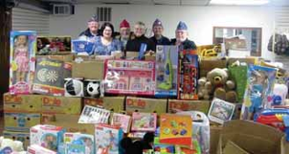
In 1932 The Forty and Eight declared war on childhood diphtheria and distributed vaccine to those who were unable to afford it.
Another program provided iron lungs for victims of polio.
Funding of worthy programs for students is a Child Welfare favorite.
Most recently we raised $21,800 for children who were impacted by hurricane Sandy. Excess funds were used for tornado victims in Indiana, where an elementary school was completely destroyed.

Slide 8
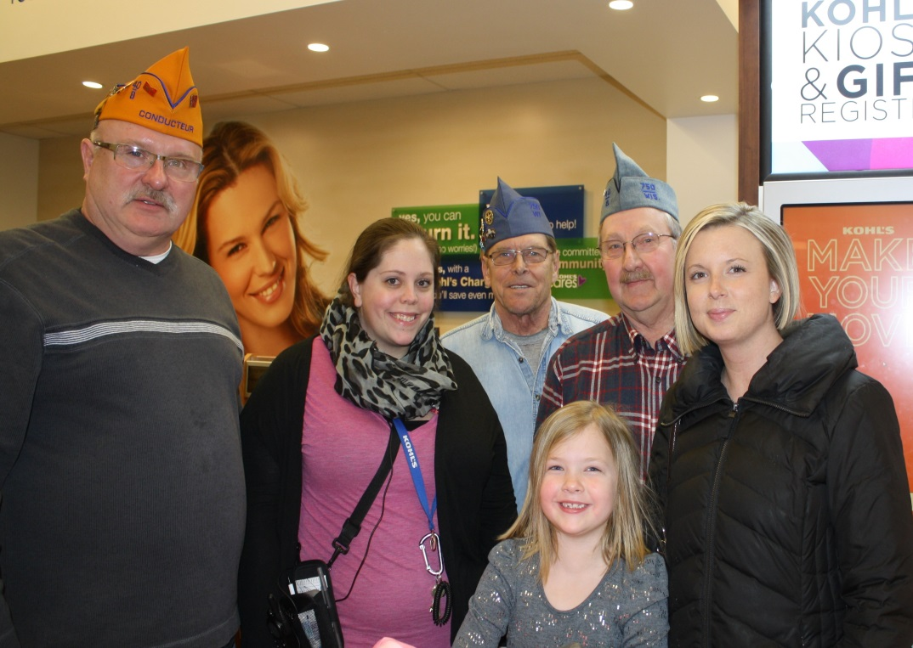
ARDERY FUND RECEIPIANT

Slide 9
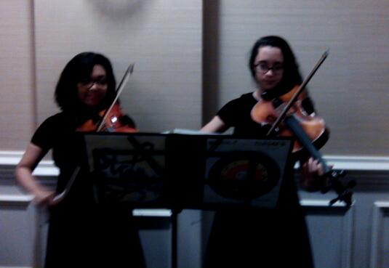
MUSIC STUDENTS AT BANQUET

Slide 10
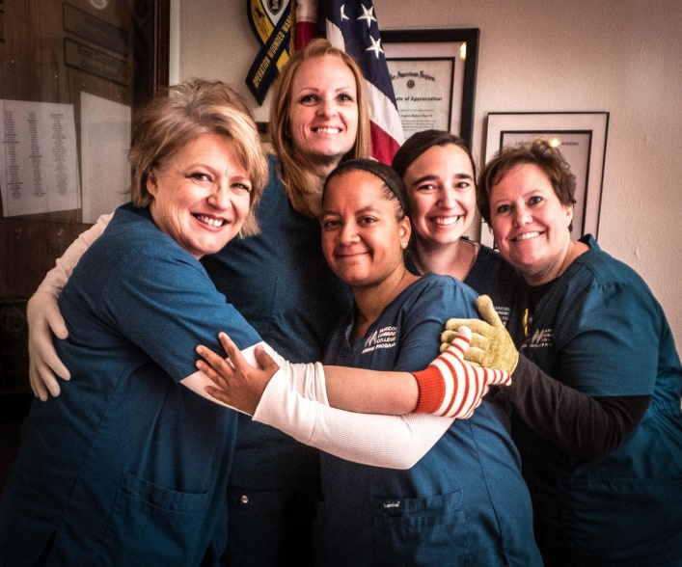
NURSES TRAINING
The Forty and Eight began issuing Nursing Scholarships in 1941.
Program officially started in 1955.
Program is primarily administered at the Locale (Voiture) level.
National money for nursing scholarships comes from the Boland Nurses Training Trust Fund.
Scholarships help many nursing students that are juggling family, child care, work, school and studying.

Slide 11
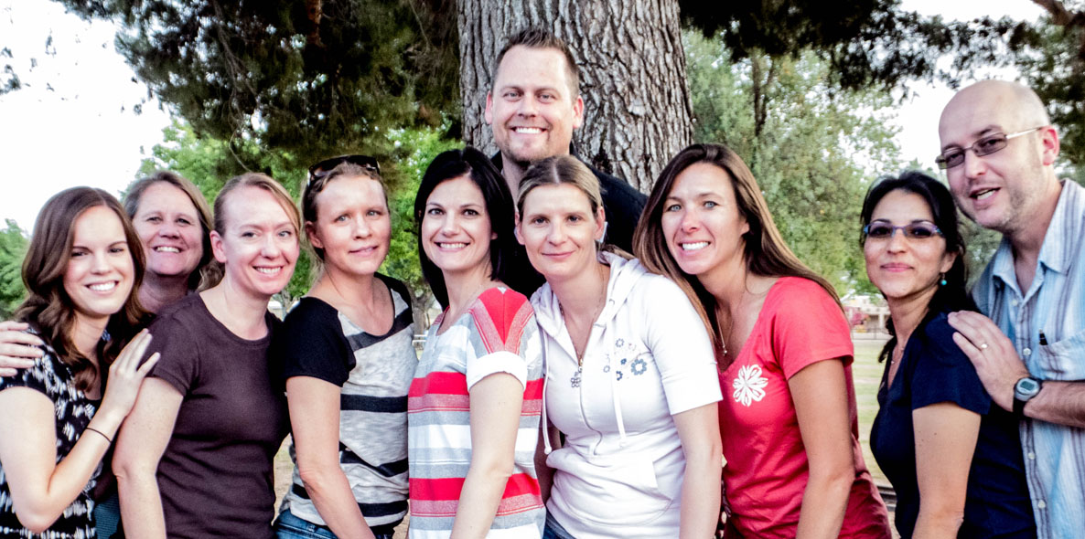

Slide 12


Slide 13
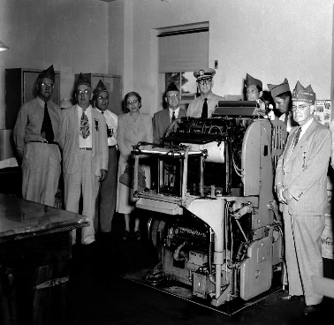
CARVILLE STAR
In 1947 the Forty and Eight began its long association with the Hanson’s Disease Program in Carville, Louisiana.
Hanson’s Disease is erroneously associated with "Biblical Leprosy“
The word Star comes from the publication “The STAR”.
The purpose of the “The Star” is to educate and enlighten the public and the medical profession on the truthful facts about Hansen’s Disease and dispel myths that date back to the biblical days. It also furnishes vocational rehabilitation for interested patients.
The STAR has a growing circulation going out to all 50 states and more than 154 foreign countries.
The Forty and Eight financially supports this program and publication.
40 & 8’rs Presenting Printing Press in 1947

Slide 14

CARVILLE STAR
There are many ways to support the Carville Star Program including:
  Star Subscriptions
  Buy A Country
  Buy A Clinic
  The Star Maintenance Fund
  Museum Fund
  Pin Sales
  General Donations

Slide 15

YOUTH SPORTS
Established in 1994 to provide financial assistance in the form of grants to individual athletes or teams who lack the funds.
To enhance physical, mental and moral development of young athletes.
Assisting all regardless of race or creed.
Some Locale’s are major supporters of “Special Olympics” in their area.
Promotes Good Sportsmanship and Citizenship.
Source of income come from sales of pins and other fund raisers.

Slide 16

POW/MIA
The 40 & 8 program is known as the “POW/MIA Survivor Scholarship Fund”
in memory of Lance Corporal John Dewy Killen who was declared Missing in Action in South Vietnam.
Scholarships are available to the Spouse, Children, Grandchildren,
Great-grandchildren, and Widows or Widower of verified POW/MIA. In remembrance of them that they are not forgotten.
Support the ongoing effort to find and repatriate the remains.
Sources of income comes for sales of pins, fund raising events and donations.

Slide 17

SPECIAL AWARDS
40 & 8 “Voyageur of the Year Award” (Locale, Grande and Nationale winners)
“Hero of the Year Award” adopted in 1991 for the purpose of recognizing and paying tribute to a person who with out hesitation performed a heroic deed and demonstrated an unselfish desire to aid others.
“Law Officer of the Year Award” is to recognize and pay tribute to a Law Officer who has done an outstanding job of performing his or her duties both passed and present.
“City or Town of the Year Award” was adopted in 2001 to recognize and honor a City or Town which has or is doing something significant for Veteran’s in that City or Town.

Slide 18
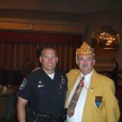
LAW OFFICER OF THE YEAR 2013

Slide 19

AMERICANISM
Voyageurs Militaire maintain a strong commitment to the
“American Way of Life”.
Americanism projects include respect for the Flag, Constitution, Law and Order and the willingness to defend these principles.
The 40 & 8 “Flags for First Graders” is an education program for elementary schools American youths on the United States Flag its, History, Respect and Protocol.
Annual National Americanism Award Winner, to an outstanding American.
Flags at Arlington Cemetery on Memorial Day (over 10,000 given to attendee’s).

Slide 20
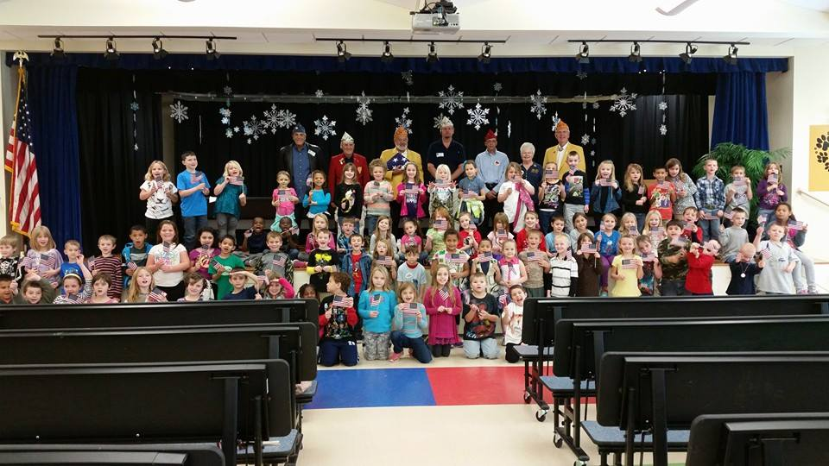
FLAGS FOR 1ST GRADERS

Slide 21
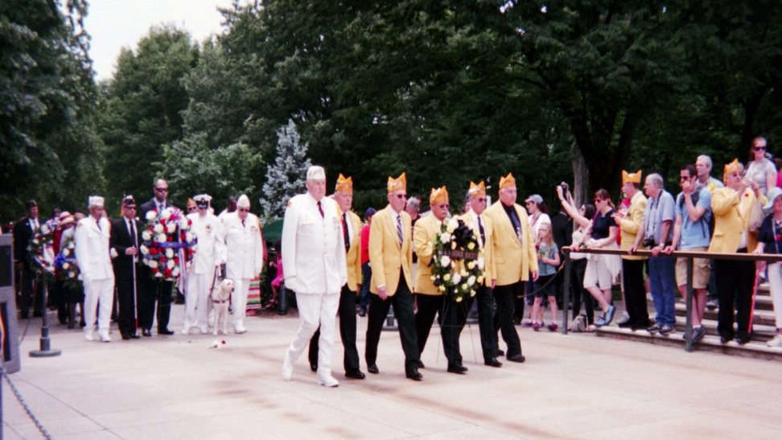
MEMORIAL DAY ARLINGTON

Slide 22
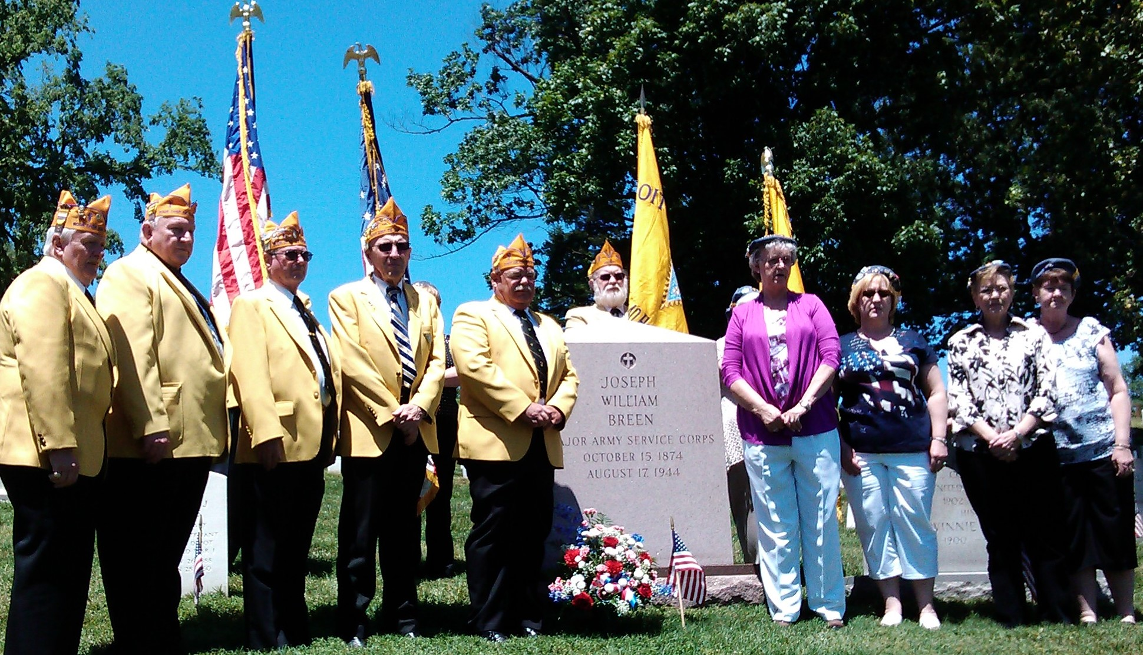
JOSEPH BREEN MEMORIAL

Slide 23
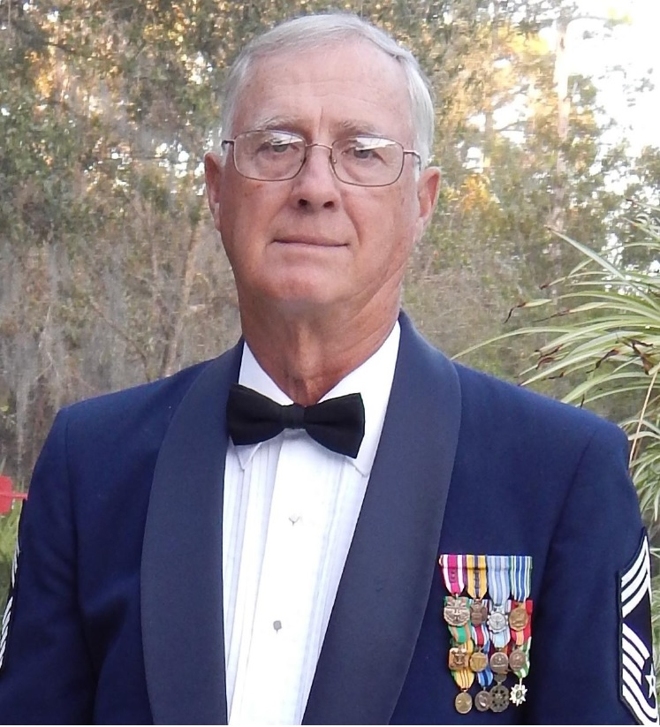
NATIONAL AMERICANISM WINNER 2014 JOHN STEWART

Slide 24
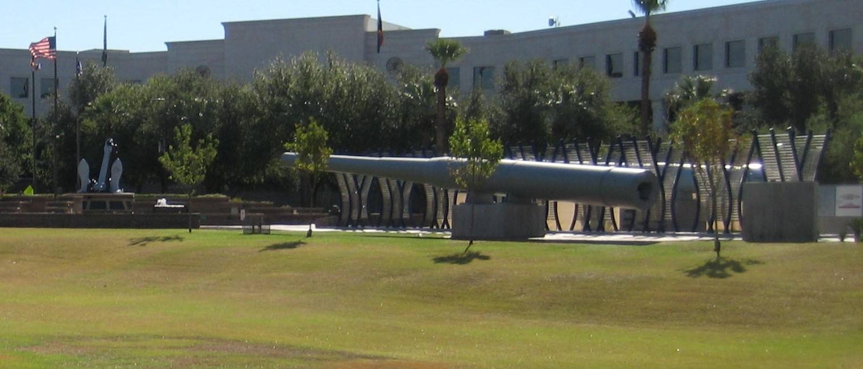
BATTLESHIP ARIZONA & WWII MEMORIAL, PHOENIX, AZ

Slide 25

V.A.V.S./S.V.H
Veterans Affairs Voluntary Services (V.A.V.S.) provides a structured Volunteer Program.
Traditional volunteers assignments include patient Escort Service/Volunteer Driver/ Information Desk Services at VA Hospital and Clinics /Chaplin Service for patients/Guest Relations Service.
Representatives and Deputies at VA Hospitals and State Veterans Home’s (S.V.H.) seek funding for Veterans needs.
The Forty and Eight’s “Keep the Wheel Chairs Rolling Program”, funds worthy project to enhance the live of veterans.

Slide 26
BOX CAR ASSOCIATION
The National Box Car Association (NBCA) was founded in 1965. Its primary mission was to preserving the Box Car symbol of the 40 & 8.
The NBCA goals are contributions to Hospitals, Children’s Homes and Orphanages. At the annual Promenade Nationale, a party for children is held in the host city where the children and their escorts are treated to lunch, train rides on visiting Locomotives, entertainment by Hobo Clowns and bands.
Also a monetary donation is made to the host city’s local VAVS Hospital. Other donations go to the National Boland Nurses Training Trust Fund, the Charles Ardery Child Welfare Trust Fund and other programs requiring assistance, such as the National 40&8 Membership Committee, 40&8 Magazine, Law Officer of the Year program, and many others. All funding raised by the NBCA are distributed in the same year it is raised.
The NBCA members are the “Kings of Raising Money”.

Slide 27
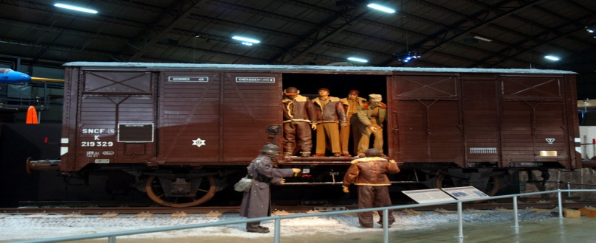
40/8 BOXCAR MUSEUM OF THE U.S.A.F

Slide 28


Slide 29
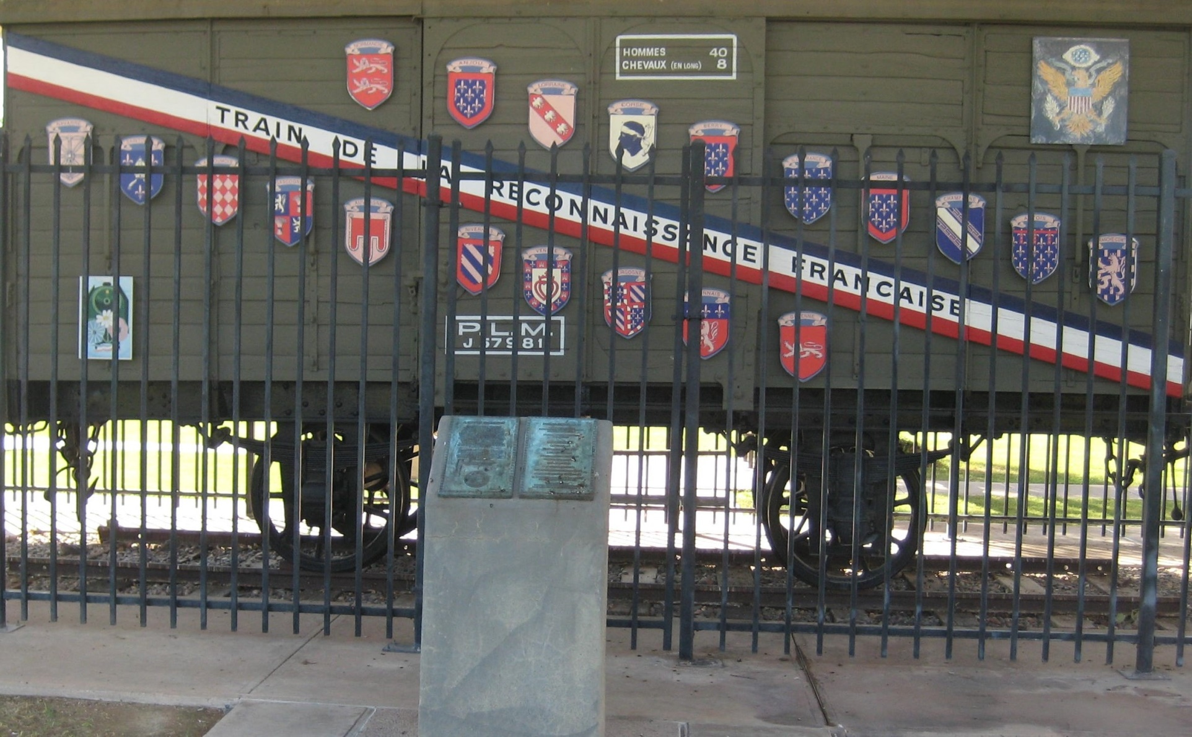
ARIZONA’S MERCI BOXCAR

Slide 30
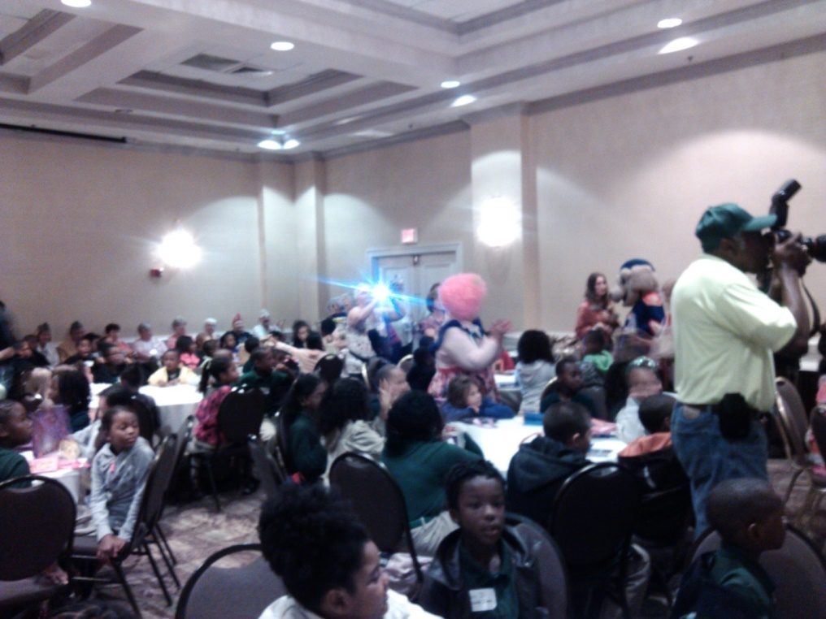
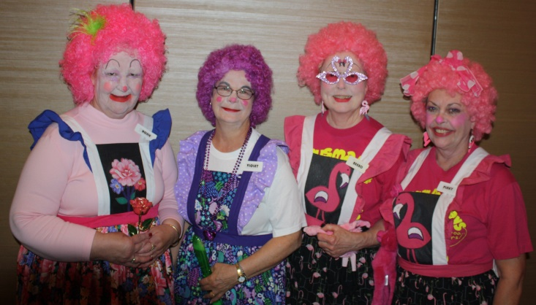
CHILDRENS PARTY

Slide 31
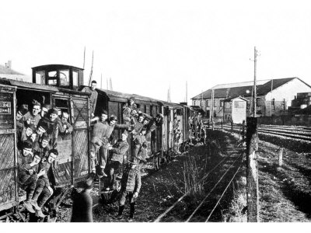
RITUAL
Provides a consistent guide to all ceremonies and memorial services.
Annually approves the current password for the coming year.
Ritual provides a link to our past and the history of this Veterans Honor Society.

Slide 32
VOITURE ACTIVIES
All activities that promote Voyageur involvement.
Some Voitures Activities programs include the following examples:
A breakfast, brunch or luncheon.
A barbeque or picnic.
A regular dinner or dinner for a special occasion.
A dance or karaoke.
A bingo or casino night.
A special party for kids.
Involement in a parade.
Patriotic holiday observances.
Public memorial services.

Slide 33
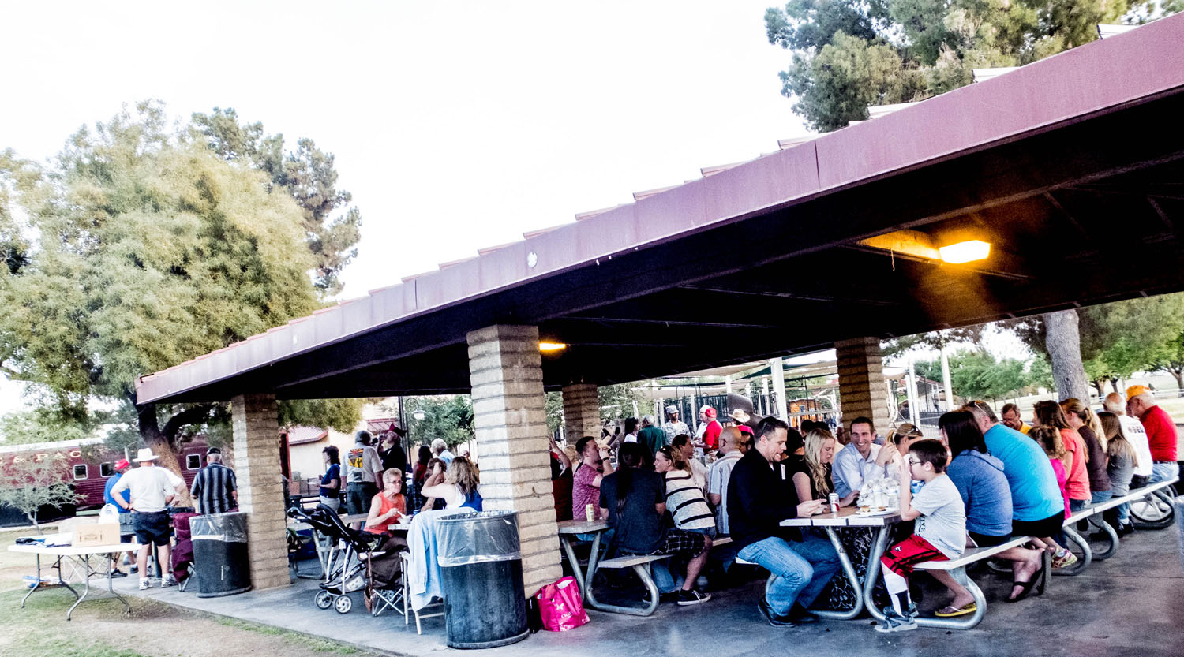
VOYAGEUR APPRICATION PICNIC

Slide 34
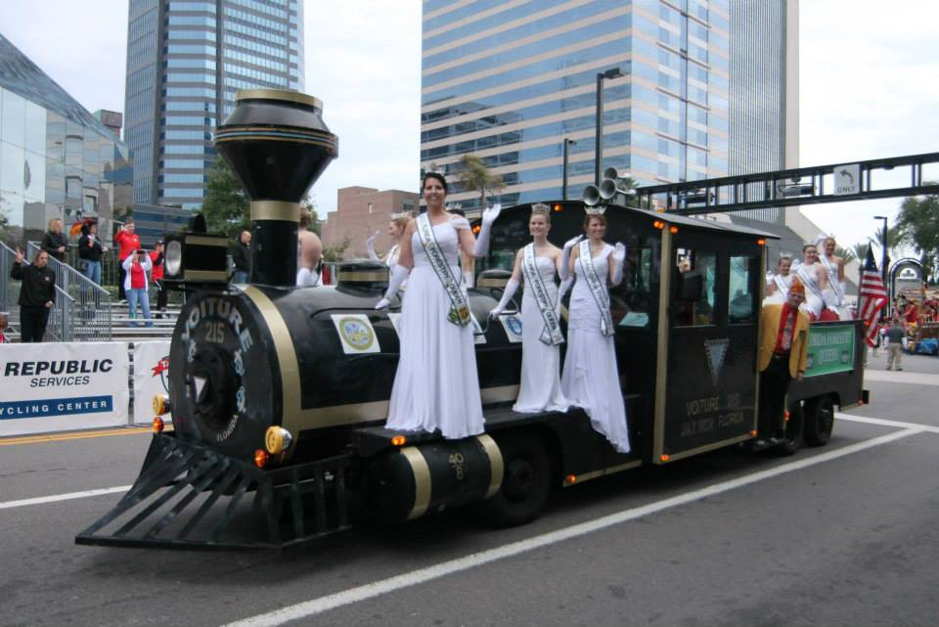
GATOR BOWL PARADE 2014

Slide 35

ANNIVERSARY CELEBRATION

Slide 36
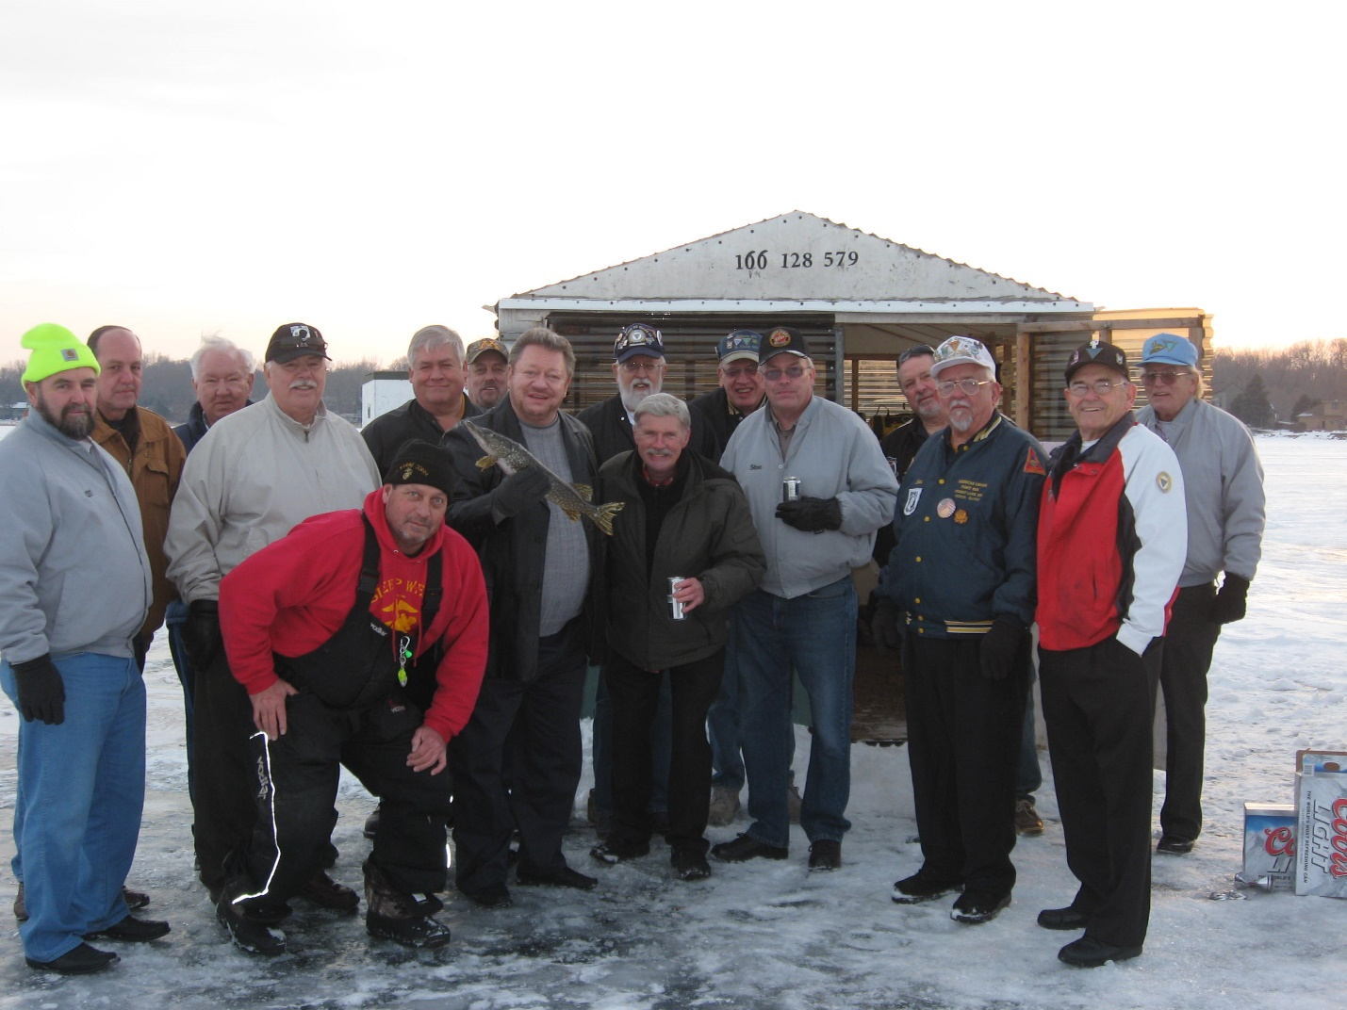
VOYAGEURS WALK ON WATER

Slide 37
VOITURE PIG ROAST
11TH Annual
VOITURE 1466
PIG ROAST
Hosted by
Chandler Post #35 P.W.F.H. 40/8
Sunday October 12, 2014
Serving Begins at 2pm
Bar Bingo at 3pm
Chandler Post #35
Whole Roasted Pig
& Chicken
Come Watch
The NFL Package
The entire Legion family and their guests are
welcome and encouraged to attend.
This is a Voiture 1466 Charity Fund Raiser.
Adults $7.00 Children 6–12 $3.50, 5 and under free.

Slide 38
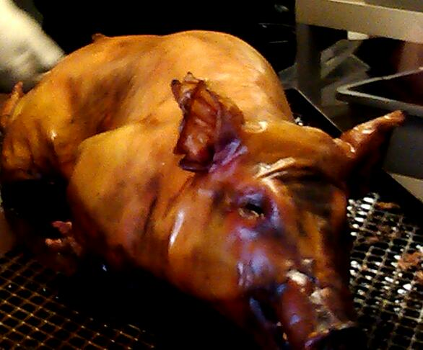
THE PIG

Slide 39
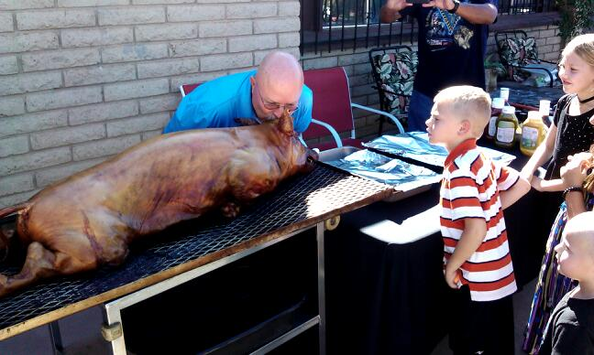
CHEF KISSING THE PIG

Slide 40
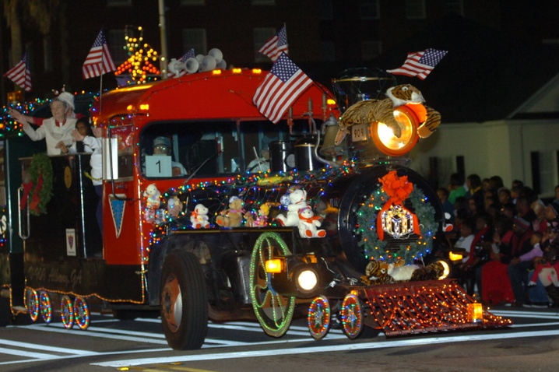
VOITURE LOCO CHRISTMAS

Slide 41
BIG GAVEL PRESENTATION

Slide 42

MEMBERSHIP
The life blood of La Societe.
Retention thru annual membership renewal.
Recruitment of Honorably Discharged Veterans.
Reinstatement of lapsed members.
Encouragement of the Paid Life Membership (PUFL) option.

Slide 43



MEMBERSHIP AWARDS

Slide 44


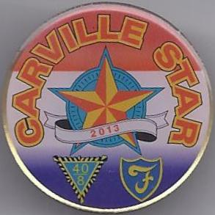




PINS PROGRAMS
Provides financial support to programs by selling nominally priced decorative
chapeau pins that represent the essence of the program.
The sale of these items represents an integral part of the programs success.
All Voiture Locales can order Pins through their respected Grande Directeur.

Slide 45

LA FEMMES
A fraternal organization of female members 18 years of age and older, with an affiliation with a veteran.
Actively aids and supports the many charitable and patriotic programs of the Forty and Eight.
Membership currently totals 3,129 Ladies.
In 2014 presented checks; Child Welfare $4,654.00., POW/MIA $5,000.oo, National Headquarters building mortgage $19,500.00.

Slide 46

NICKELS FOR NURSES TRAINING
Is a La Femmes Program to
Assist in Scholarship Funding
For Nurses Training
Scholarships

Slide 47
IN SUMMATION
It is about
SERVICE
SERVICE
SERVICE

Slide 48
CHARITY
Children
Young People
Under Privileged
Veterans

